Slide 1




TACTICAL COMBAT CASUALTY CARE COURSE
Module 1: Principles and Application of TCCC
#TCCC-CPP-PPT-01 08 AUG 23
COMBAT PARAMEDIC/ PROVIDER
MODULE 1:
PRINCIPLES AND APPLICATION OF TACTICAL COMBAT CASUALTY CARE (TCCC)
TCCC TIER 1
All Service Members
TCCC TIER 2
Combat Lifesaver
TCCC TIER 3
Combat Medic/Corpsman
TCCC TIER 4
Combat Paramedic/Provider
Notes:
Welcome to the Combat Paramedic or Provider, or CPP, course for Tactical Combat Casualty Care.

Slide 2
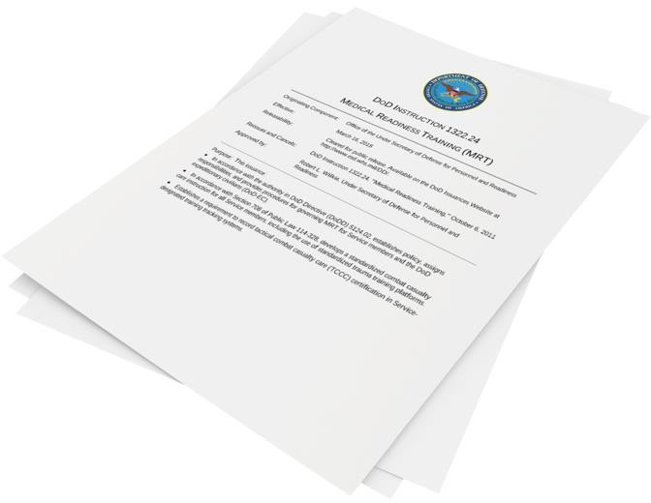
Module 1: Principles and Application of TCCC
NDAA 2017 section 708
DoDI 1322.24
Standardizes Combat Casualty Care for all Service members
Mandates the use of a standardized
trauma training platform
#TCCC-CPP-PPT-01 08 AUG 23
2
Notes:
Recognizing that Tactical Combat Casualty Care (TCCC) is the standard of care in battlefield prehospital medicine, DoDI 1322.24, Medical Readiness Training, implemented standardized combat casualty care training for all Service members.¹ This training focuses on lifesaving skills and is tailored to the level of care that an individual might be expected to perform. If you have not been trained in TCCC, then your previous medical training may not have contained the material presented in the following lessons.

Slide 3
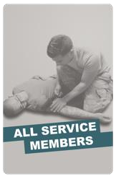
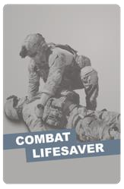
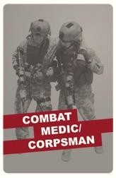
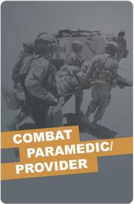
Module 1: Principles and Application of TCCC
TACTICAL COMBAT CASUALTY CARE (TCCC) ROLE-BASED TRAINING SPECTRUM
ROLE 1 CARE
NONMEDICAL PERSONNEL
MEDICAL PERSONNEL
YOU ARE HERE
STANDARDIZED JOINT CURRICULUM
#TCCC-CPP-PPT-01 08 AUG 23
3
Notes:
Tactical Combat Casualty Care is broken up into four roles of care:
The most basic is All Service Members (ASM) and includes the absolute basics of hemorrhage control and basic recognition of more serious problems.
The Combat Lifesaver (CLS) is taught more advanced skills needed to treat the most common causes of preventable death due to traumatic injuries including hemorrhage (from the extremities / junctional areas), tension pneumothorax, and airway trauma or obstruction. They are also taught to identify and treat other not immediately life-threatening injuries.
The Combat Medic/Corpsman (CMC) is the first medical provider to care for the casualty in the prehospital environment and is expected to provide more advanced care requiring significantly more medical knowledge and skills.
The most advanced role is yours, as the CPP, and you are expected to provide the most sophisticated care to keep our wounded warriors alive and get them to definitive care.

Slide 4
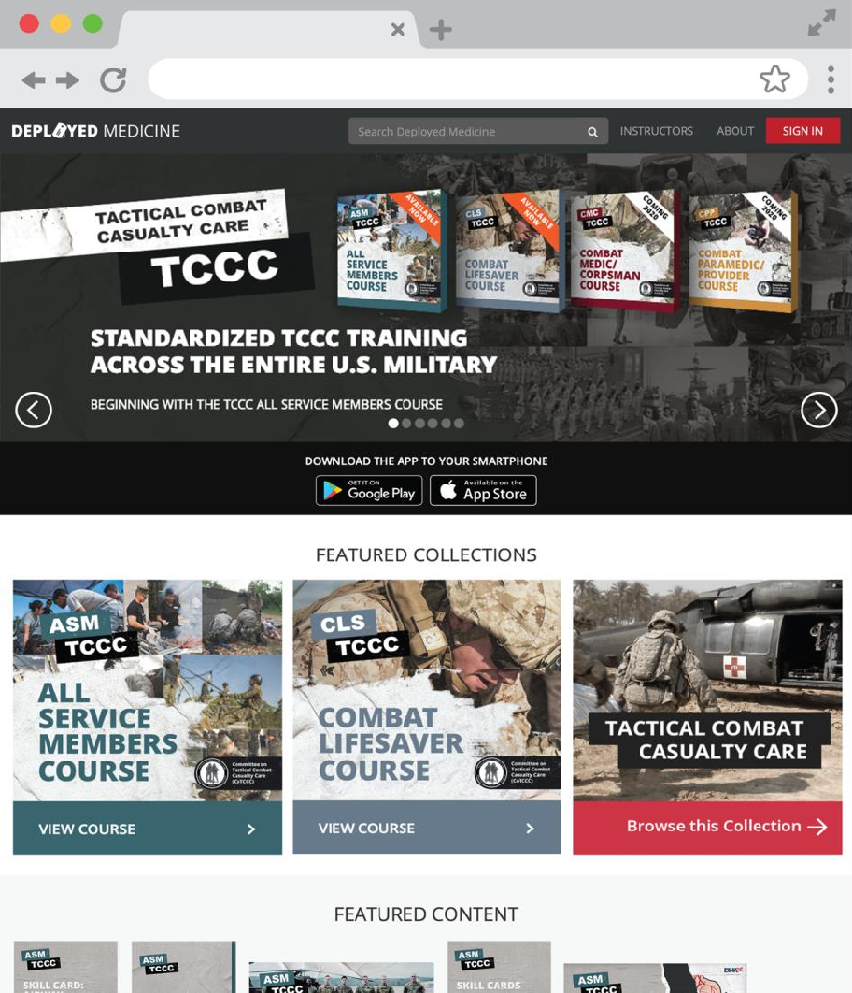

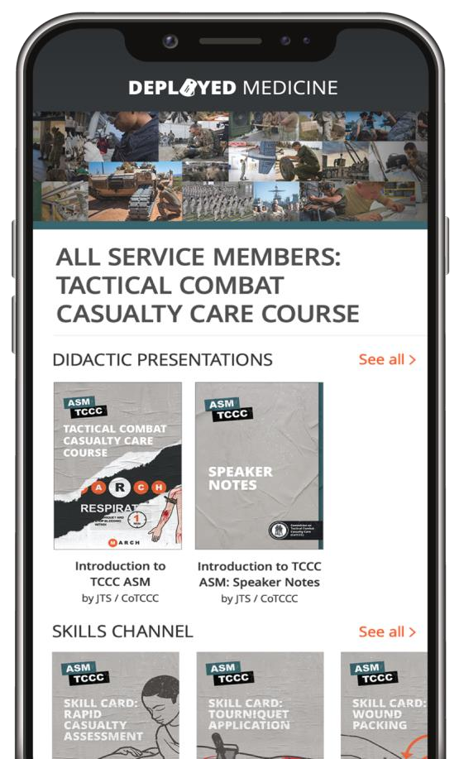
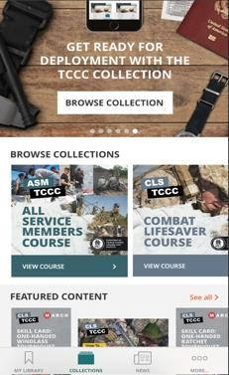


This isn’t your typical
first aid training
Module 1: Principles and Application of TCCC
Training & Education Resource
All Service Members (ASM),Combat Lifesaver (CLS), Combat Medic /Corpsman (CMC), and Combat Paramedic/Provider (CPP) TCCC Curriculum
Updated videos, podcasts, and resources Download CPGs to your phone
www.deployedmedicine.com
#TCCC-CPP-PPT-01 08 AUG 23
4
Notes:
Feedback from trainers and trainees indicated that the prior methods for TCCC training were heavy in PowerPoint slides, and that more time performing procedures and applying those principles to realistic scenarios would be beneficial. Also, updates seemed to take months to make it to the field for implementation. Responding to that feedback, the decision was made to develop a web- and mobile-based platform for both classroom support and job performance support outside of the classroom. Deployed Medicine² is the result of those efforts and is a continuously evolving platform where you can find classroom materials and other aids to learn more about TCCC.

Slide 5
Module 1: Principles and Application of TCCC
WHAT THIS COURSE CONTAINS
Principles and Applications of TCCC
Shock Recognition Fractures and Management
Casualty Monitoring
Medical Equipment
Hemorrhagic Shock Fluid Resuscitation
Communication
Care Under Fire
Hypothermia Prevention and
Treatment
Cardiopulmonary Resuscitation
Principles and Application of Tactical Field Care
Documentation
Head Injuries
Tactical Trauma Assessment
Preparation for Evacuation
Eye Injuries
Massive Hemorrhage Control
Pain Medications (Analgesia)
Airway Management
Antibiotic Administration
Respiration Assessment and Management
Wound Management
Circulation/Hemorrhage Control
Burns
#TCCC-CPP-PPT-01 08 AUG 23
5
Notes:
This CPP course builds on the CMC TCCC course, previously known as the TCCC Medical Provider (TCCC-MP) course, but adds additional information and skill requirements tailored to your level of training. The course objectives reflect the priorities that the Joint Service Working Group, commissioned by the Defense Health Agency, the Committee on Tactical Combat Casualty Care, and Joint Trauma System, felt were important for CPP personnel. These are the 27 different modules we will cover.

Slide 6












Module 1: Principles and Application of TCCC 1 x TERMINAL LEARNING OBJECTIVE
01 Describe the practice of TCCC in accordance with CoTCCC Guidelines.
1.1
Identify the leading causes of preventable death due to traumatic injuries and the corresponding interventions to help increase chances of survival.
Describe the TCCC Phases of Care and how intervention priorities differ in each phase, in accordance with CoTCCC Guidelines.
Describe the application of TCCC in combat and
noncombat settings across different environments.
Describe the role and responsibilities of all non-medical and medical personnel in rendering TCCC care in accordance with Joint Publication 4-02 and DoDI 1322.24.
Identify the key factors influencing TCCC. Identify the importance of TCCC training. Identify the three objectives (or goals) of TCCC.
1.8
Identify the lifesaving impacts of TCCC implementation in prehospital trauma care.
Identify methods used to stay current and up-to-date with TCCC Guidelines and protocols.
1.9
1.2
1.10 Identify the origins of TCCC, including the Committee on Tactical Combat Casualty Care (CoTCCC), and define the importance of CoTCCC Guidelines/Recommendations.
1.3
Identify the methodology for TCCC Guideline changes and
revisions.
1.12 Identify TCCC training methods ensuring unit readiness in achieving no losses due to preventable combat deaths.
1.4
1.11
1.5
1.6
1.7
1.13 Identify the mission and purpose of the Joint Trauma System and its role in combat casualty care at the unit level.
13 x ENABLING LEARNING OBJECTIVES
= Cognitive ELOs = Performance ELOs
#
= Terminal Learning Objectives
#TCCC-CPP-PPT-01 08 AUG 23
6
Notes:
This first module will focus on the basic principles and application of TCCC. At the end of the course, you will be expected to demonstrate the application of TCCC skills in a practical exercise. This module, along with those that follow, will set the stage for you to successfully complete that demonstration.
Throughout the course, you’ll see the enabling learning objectives listed as cognitive or psychomotor. The cognitive objectives are knowledge-based, while the psychomotor objects require that you learn and demonstrate a skill.
There are 13 cognitive learning objectives for this first module listed on this slide. Unlike future modules that primarily focus on clinical knowledge and skills, this module will help you understand the basis for the development of TCCC and its value to the warfighter, as well as help prepare you to be able to oversee training for others in your organization.

Slide 7


Module 1: Principles and Application of TCCC
Intro to Tactical Combat Casualty Care (TCCC)
7

Slide 8
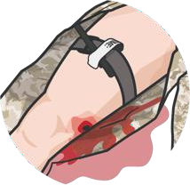
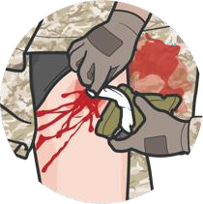
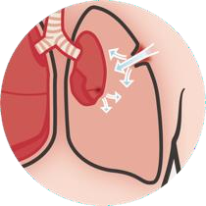
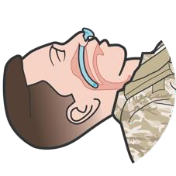
LEADING CAUSES OF PREVENTABLE COMBAT DEATH DUE TO TRAUMATIC INJURIES
Module 1: Principles and Application of TCCC
EXTREMITY HEMORRHAGE
Intervention:
Limb tourniquet
JUNCTIONAL HEMORRHAGE
Intervention: Hemostatic dressing and wound packing;
Junctional tourniquet
TENSION PNEUMOTHORAX
Intervention:
Needle decompression
of the chest (NDC)
Chest tube insertion
AIRWAY TRAUMA/
OBSTRUCTION
Intervention:
Airway maneuvers,
nasopharyngeal airway
Advanced surgical
airways or ETT intubation
Notes:
The leading causes of preventable combat death due to traumatic injuries include hemorrhage, from the extremities/junctional areas, tension pneumothorax, and airway trauma or obstruction.³ By far, the majority of preventable deaths were from massive hemorrhage.
Throughout this course, you will notice the emphasis on controlling bleeding, whether that be through tourniquet placement on the extremities, the use of hemostatic dressings and wound packing, or the use of junctional tourniquets. But we still need to be cognizant of respiration and airway issues and be prepared to do needle decompression of the chest or chest tube insertions and control the airway through airway maneuvers or advanced airway procedures.

Slide 9
Three PHASES of TCCC
Module 1: Principles and Application of TCCC
1
CARE UNDER FIRE (CUF)
/ THREAT
2
TACTICAL FIELD CARE (TFC)
3
TACTICAL EVACUATION CARE (TACEVAC)
RETURN FIRE AND TAKE COVER
WORK UNDER COVER AND CONCEALMENT
MORE DELIBERATE ASSESSMENT AND PRE- EVACUATION PROCEDURES
Notes:
As you observed during the video, TCCC has three main phases of care.⁴
Care Under Fire (CUF)/Threat
Tactical Field Care (TFC)
Tactical Evacuation Care (TACEVAC).
Each has specific considerations to keep in mind, both for the threats that may impact what care can be delivered and the priorities for treatment.

Slide 10
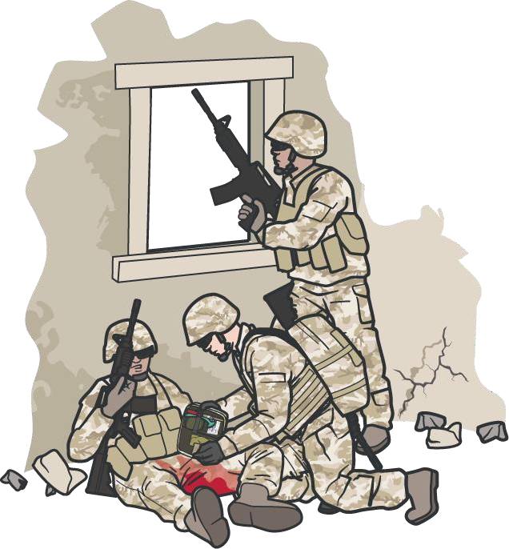


PHASE 1: CARE UNDER FIRE / THREAT
Module 1: Principles and Application of TCCC
RETURN FIRE AND
TAKE COVER
DIRECT CASUALTY
TO REMAIN ENGAGED
NEVER ATTEMPT
to rescue a casualty until hostile fire is suppressed
HAVE CASUALTY MOVE
TO COVER AND APPLY
SELF-AID (if able)
or
MOVE OR DRAG
CASUALTY TO COVER
(if tactically feasible)
Using available resources, ensure
scene safety
KEEP CASUALTY FROM SUSTAINING ADDITIONAL WOUNDS
Notes:
The first phase is Care Under Fire, or in the case of a noncombat environment, Care Under Threat. In this phase, the scene is not safe, and the overall priority is to establish scene safety in the form of fire superiority or control of any threats from a noncombat environment. The TCCC Guidelines outline seven steps for the basic management plan for Care Under Fire:⁵
Return fire and take cover.
Direct the casualty to remain engaged as a combatant if appropriate.
Direct the casualty to move to cover and apply self-aid if able or when tactically feasible, move or drag casualty to cover.
Try to keep the casualty from sustaining additional wounds.
Casualties should be extracted from burning vehicles or buildings and moved to places of relative safety. Do what is necessary to stop the burning process.
Stop life-threatening hemorrhage if tactically feasible.

Slide 11
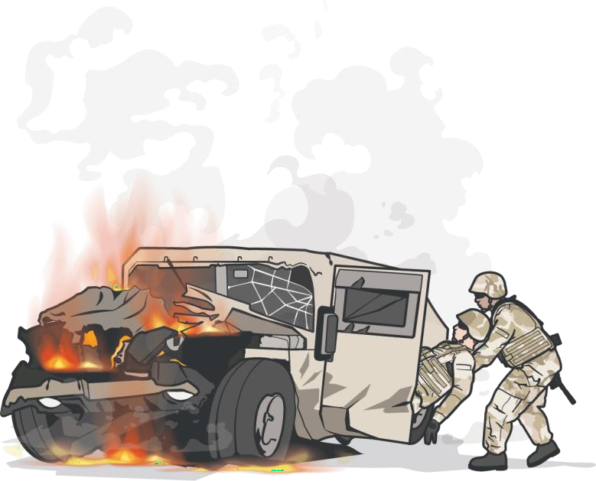
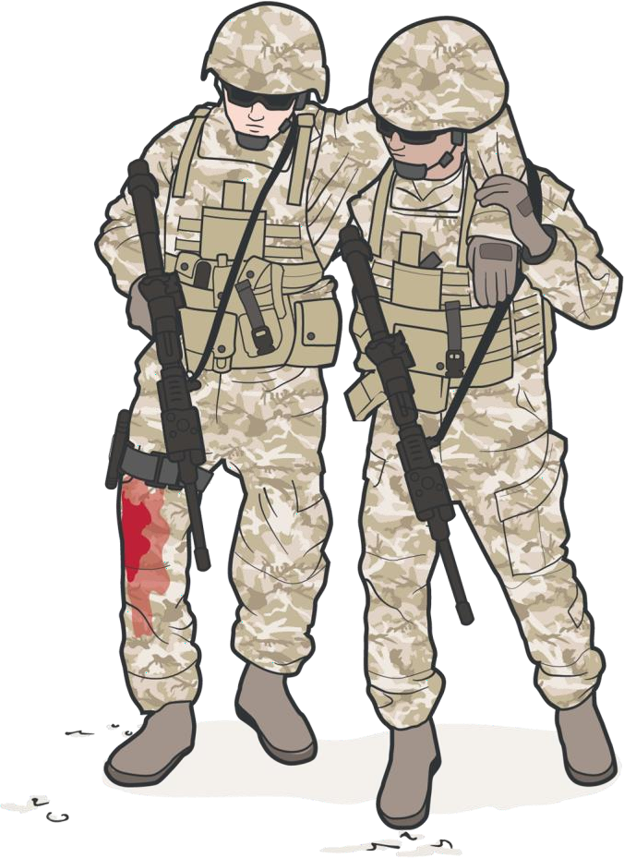


PHASE 1: CARE UNDER FIRE / THREAT (CONT.)
Module 1: Principles and Application of TCCC
CASUALTIES SHOULD
BE EXTRACTED AND
MOVED to relative safety
once scene is secure
STOP LIFE-THREATENING
EXTERNAL HEMORRHAGE
(if tactically feasible)
For life-threatening bleeding, place a tourniquet over the uniform “proximal” to the bleeding site(s)
NOTE: If life-threatening bleeding is not readily apparent, place tourniquet as proximal as possible on injured limb
Stop the burning process, if relevant
MOVE the CASUALTY to cover
IMPORTANT CONSIDERATION:
Continuously assess risks and make a plan before moving a casualty
Notes:
1. Casualties should be extracted from burning vehicles or buildings and moved to places of relative safety. Do what is necessary to stop the burning process.
2. Stop life-threatening external hemorrhage if tactically feasible:
Direct casualty to control hemorrhage by self-aid if able.
Use a CoTCCC-recommended limb tourniquet for hemorrhage that is anatomically amenable to tourniquet use.
Apply the limb tourniquet over the uniform clearly proximal to the bleeding site(s). If the site of the life-threatening bleeding is not readily apparent, place the tourniquet “high and tight” (as proximal as possible) on the injured limb.
3. Move the casualty to cover.

Slide 12
MARCH PAWS
Module 1: Principles and Application of TCCC
POTENTIALLY LIFE-THREATENING
MASSIVE BLEEDING
AFTER LIFE-THREATENING
PAIN ANTIBIOTICS
WOUNDS SPLINTING
M A R C H
#1 priority
P A W
AIRWAY
RESPIRATION (breathing)
CIRCULATION
S
HYPOTHERMIA /
HEAD INJURIES
Notes:
Before moving on to the Tactical Field Care phase, this is a good time to introduce the MARCH PAWS approach and how it can help you decide on assessment and treatment priorities.
MARCH is a mnemonic to remind you of the sequence of priorities for assessing and treating potentially life-threatening issues during the Tactical Field Care phase, beginning with massive bleeding. Any time your assessment reveals the need for an intervention or treatment, pause the assessment to complete the treatment and then resume the assessment where you left off.
PAWS is also part of Tactical Field Care if the tactical situation permits and/or if you have no other casualties that require your attention for immediate life-threatening issues. You’ll see this throughout the course, and it will also be helpful during your practical exercises.

Slide 13
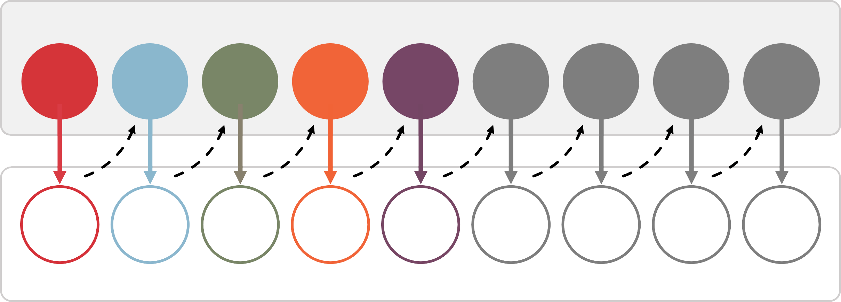
TACTICAL TRAUMA ASSESSMENT PROCESS
Module 1: Principles and Application of TCCC
Assessment
M | A | R | C | H | P | A | W | S
M | A | R | C | H | P | A | W | S
Intervention(s)
Notes:
Throughout the rest of the course, we will cover the interventions and procedures of MARCH PAWS in more detail. Although we’ll take a moment to highlight some key concepts that apply throughout the TTA, we’ll defer discussions about the specific interventions until their corresponding module. For now, the focus should be more on the process than on the details of each procedure.
Remember that when performing an assessment, you will need to go back and forth from assessing the need for an intervention to performing a skill, and then return to assessing for the next potential injury. So, although we call this an assessment, the entire process is a combination of an assessment and a treatment plan being executed simultaneously.

Slide 14
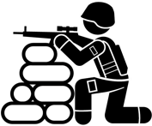





PHASE 2: TACTICAL FIELD CARE
Module 1: Principles and Application of TCCC
ESTABLISH SECURITY
PERIMETER
TRIAGE
CASUALTIES
ASSESSMENT
AND TREATMENT
COMMUNICATION
DOCUMENTATION OF CARE
PREPARATION
FOR EVACUATION
Notes:
During Tactical Field Care, the TCCC Guideline basic management plan includes the following steps:⁶
Establish a security perimeter in accordance with unit tactical standard operating procedures and/or battle drills and maintain tactical situational awareness.
Triage casualties as required. Casualties with an altered mental status should have weapons and communications equipment taken away immediately.
Assessment and treat following the MARCH PAWS sequence.
Communicate.
Document.
Prepare for evacuation.

Slide 15
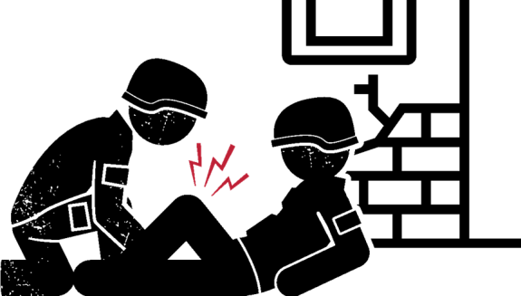


PHASE 2: TACTICAL FIELD CARE (cont.)
Module 1: Principles and Application of TCCC
TACTICAL FIELD CARE
LIMITED SUPPLIES
The casualty and the person rendering care are NOT under direct fire
TFC can turn into
Care Under Fire unexpectedly
Personnel should maintain
SITUATIONAL AWARENESS
Medical equipment and supplies are limited to what is carried into the field by the CPP, any CMC, CLS, and the INDIVIDUAL SERVICE MEMBER
Always use the casualty’s
Joint First Aid Kit (JFAK) first
REMEMBER: Intervention priorities should follow MARCH PAWS
Notes:
Keep in mind that Tactical Field Care can always revert to a Care Under Fire situation if scene safety is compromised. This is why there is such an emphasis on maintaining situational awareness of the surroundings and not using all of your resources to focus on casualty care.
Supplies in the field are usually limited. Exercise care by using the casualty’s JFAK initially; then use the supplies from your unit’s combat lifesaver kits (if available) or whatever Combat Medics/Corpsmen may have brought in their CMC aid bag before beginning to use your CPP supplies and equipment.
And, as always, be sure to prioritize your assessment and treatments by following the MARCH PAWS sequence we mentioned earlier.

Slide 16









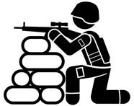



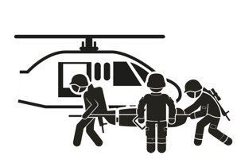

PHASE 3: TACTICAL EVACUATION CARE
Module 1: Principles and Application of TCCC
COMMUNICATING CASUALTY INFORMATION
STAGING/LOADING
CASUALTIES
ESTABLISH EVACUATION POINT SECURITY/STAGE CASUALTIES FOR EVACUATION
LOAD/SECURE CASUALTIES
REASSESSING/ RE-EVALUATING

Slide 17
Three PHASES of TCCC
Module 1: Principles and Application of TCCC
TACEVAC
DELIBERATE ASSESSMENT PRE-EVACUATION PROCEDURES
CUF / Threat
RETURN FIRE AND TAKE COVER
TFC
WORK UNDER COVER AND CONCEALMENT
1
2
3
Direct the casualty to remain engaged
Direct the casualty to move to cover
Keep casualty from sustaining additional wounds
Stop life-threatening external hemorrhage
Move casualty to cover
Establish a security perimeter and maintain tactical situational awareness
Triage casualties
Assess and treat following
MARCH PAWS sequence
Communicate
Document care Prepare casualty for
evacuation
Establish evacuation point security and stage casualties
Communicate casualty
information to TACEVAC
TACEVAC personnel stage casualties on evacuation platforms
Secure casualties in
evacuation platform
Re-assess and re-evaluate all injuries / interventions
Notes:
In summary, your casualty is likely to go through three distinct phases of care between point of injury and evacuation to a higher level of care. Each has different limitations and dictates different approaches to casualty assessments and treatments.
Some of the key points of the basic management plan are summarized on this slide. The individual modules you go through later in the course will provide even more detail.

Slide 18




APPLICATION OF TCCC IN COMBAT VERSUS NONCOMBAT SETTINGS
Module 1: Principles and Application of TCCC
MOTOR VEHICLE
ACCIDENT
ACTIVE SHOOTER
WORKPLACE
ACCIDENT
REMEMBER! The principles of TCCC apply to all of these varied-use cases
Notes:
The principles of TCCC apply to trauma in both combat and noncombat settings.^{8,9} Severe bleeding or an amputation from a motor vehicle accident requires the same assessment and treatment you would render to a combatant who was injured from an IED blast. An active shooter produces the same ballistic injuries as an enemy combatant. Workplace accidents, vehicle rollovers, fires, explosions, burns, or other training accidents have accounted for a significant number of military noncombat injuries, all of which can be approached using the same principles of TCCC.

Slide 19
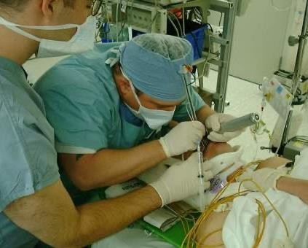
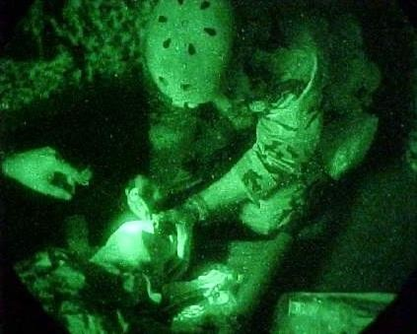
APPLICATION OF TCCC IN DIFFERENT ENVIRONMENTS
Module 1: Principles and Application of TCCC
VS
CIVILIAN OR MILITARY
HOSPITAL SETTING
COMBAT OR AUSTERE FIELD SETTING
Notes:
Although the principles of TCCC apply to trauma in both combat and noncombat settings, the environmental differences can play a significant role in how those principles are applied.
For example:
Hostile fire
Darkness
Environmental extremes
Different wounding epidemiology
Limited equipment
Need for tactical maneuver
Long delays to hospital care
Different medic training and experience
If a ballistic injury occurs in an urban setting with highly capable trauma surgery assets and rapid evacuation to a nearby civilian or military hospital, the issues surrounding assessment, treatment options, and casualty evacuation preparation will be very different than in an austere hostile setting, where a higher level of care is not readily available and responders are working in an austere location. TCCC Guidelines and training were developed assuming that most scenarios would lack nearby advanced trauma and evacuation assets.

Slide 20
ROLES AND RESPONSIBILITIES OF ALL SERVICE MEMBERS
Module 1: Principles and Application of TCCC
CARE UNDER
FIRE/THREAT
In a CUF situation the
All Service Member should:
Ensure scene safety
Move casualty to safety
Identify and control
life-threatening bleeding
TACTICAL
FIELD CARE
In a TFC situation, the
All Service Member should:
Perform a Rapid Casualty Assessment
Follow MARCH sequence & render any
treatments they have been trained on
Seek help as directed by unit standard
operating procedure(s)
Notes:
CPP personnel are not alone in providing medical care from the point of injury through evacuation to a more advanced role of care. All Service members are required to have some basic medical training.
With the new medical readiness training instruction, this is changing from prior Service-specific basic first aid or self-aid and buddy care training to the DHA standardized TCCC-All Service Members (ASM) training, though Services may still have additional medical training that they add based on their mission and risks associated with that environment.
In addition to the ASM personnel's basic understanding of the MARCH sequence, they will be trained on five lifesaving skills:¹⁰
Rapid casualty assessment
Tourniquet application
Hemostatic dressing/wound packing
Pressure bandages
Basic airway maneuvers

Slide 21
ROLES AND RESPONSIBILITIES OF COMBAT LIFESAVERS
Module 1: Principles and Application of TCCC
CARE UNDER
FIRE/THREAT
In a CUF situation the Combat Lifesaver
should:
Suppress hostile fire to minimize the risk of injury to personnel and minimize additional injury to previously injured Service members
Assist in providing self-aid and
moving casualties, if feasible
TACTICAL
FIELD CARE
In a TFC situation, the Combat Lifesaver
should:
Maintain security and situational awareness
Perform casualty assessments
Follow MARCH PAWS protocol to render any treatments they have been trained on
Support the CMC or CPP, as directed

Slide 22
ROLES AND RESPONSIBILITIES OF THE COMBAT MEDIC/CORPSMEN
Module 1: Principles and Application of TCCC
CARE UNDER
FIRE/THREAT
TACTICAL FIELD CARE
TACTICAL EVACUATION CARE
The CMC should:
The CMC should:
The CMC should:
Suppress hostile fire to minimize new or additional injury to casualties
Assist in providing self-aid
and moving casualties, if feasible
Assume the primary role for casualty assessment and treatment
Manage and direct casualty response efforts utilizing all available responders
Support the CPP, as
directed
Reassess casualties before arrival of evacuation assets
Communicate findings to the TACEVAC medical personnel
Ensure proper staging
and support loading
Secure casualties on the
evacuation platform
Notes:
Combat Medics/Corpsmen are responsible for specialized first aid, triage, resuscitation, and stabilization, as well as casualty collection from the point of wounding and preparation of casualties for evacuation to a higher role of care. In CUF, their role is to first suppress hostile fire like the CLS, but in TFC they assume the primary role for casualty assessment and treatment, following the TCCC Guidelines.
In addition, they can manage and direct the on-scene casualty response efforts utilizing all available responders, providing guidance and direction to their activities. They are also responsible for preparing the casualties for evacuation.
In the TACEVAC phase, they are responsible for reassessing the casualties immediately before the arrival of the evacuation assets, communicating findings to the TACEVAC medical personnel, ensuring proper staging, and supporting the loading and securing of casualties on the evacuation platform.

Slide 23
ROLES AND RESPONSIBILITIES
OF THE COMBAT PARAMEDIC/PROVIDER
Module 1: Principles and Application of TCCC
CARE UNDER FIRE/THREAT
TACTICAL FIELD CARE
TACTICAL EVACUATION CARE
The CPP should:
The CPP should:
The CPP should:
Suppress hostile fire to minimize new or additional injury to casualties
Assist in providing self-aid and moving casualties,
if feasible
Provide casualty assessment and treatment when functioning as the unit medic
Manage and direct casualty response efforts utilizing all available responders
Reassess casualties, communicate findings to TACEVAC medical personnel, ensure proper staging
and support loading, and secure casualties on the evacuation platform
Additional roles include medic training program development and management
and the overall direction of the Role 1 medical response system
Notes:
As a Combat Paramedic or Provider, you have the same responsibilities as the Combat Medic when functioning as the unit medic. In CUF, you also suppress hostile fire like the CLS and CMC, and in TFC you assume the primary role for casualty assessment and treatment, following the TCCC Guidelines. But there are some procedures and situations that your more advanced training may allow you to address closer to the point of injury than in cases where CMCs do not have immediate access to more advanced providers. Also, like the CMC-level provider, you will manage and direct on-scene casualty response efforts, coordinating the activities of other responders, both medical and nonmedical.
Additionally, you play a key role in ensuring that the training programs for the medics in your unit are preparing them for their deployed roles, and for the overall direction of the Role 1 medical response system.

Slide 24

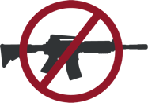
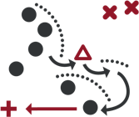
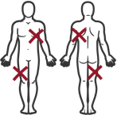
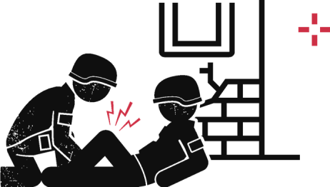


KEY FACTORS INFLUENCING TCCC
Module 1: Principles and Application of TCCC
Hostile fire
Tactical
considerations
Wounding
patterns
Environmental
considerations
Level of first responder training and experience
Equipment constraints
Delays in reaching higher levels of care
Notes:
Several factors influence the delivery of TCCC and are worth mentioning, as understanding them can help you prepare yourself and your CMC or CLS personnel to deliver better care.¹¹ Some of these were partially highlighted when we described the application of TCCC in different environments but warrant being repeated because of their importance. Although not inclusive, these factors include:
Hostile environments – if you are not under fire, that risk is always present and requires some of your attention.
Tactical environments – your situation will dictate your movements and communication options, as well as access to support personnel.
Wound pattern differences – depending on your mission profile, you may anticipate different threats which may make certain injury patterns more likely.
Environmental considerations – more often than not, you will need to deal with poor lighting, austere conditions, and maybe inclement weather.
Unknown response personnel capabilities – in the best-case scenario, you will have had time to train and work with your ASM, CLS, and CMC personnel, but that is not always the case.
Resource limitations – tactical considerations may limit what you can take with you, and resupply can be erratic (or nonexistent).
Evacuation delays – the potential for significant delays may lead to prolonged field care issues.

Slide 25

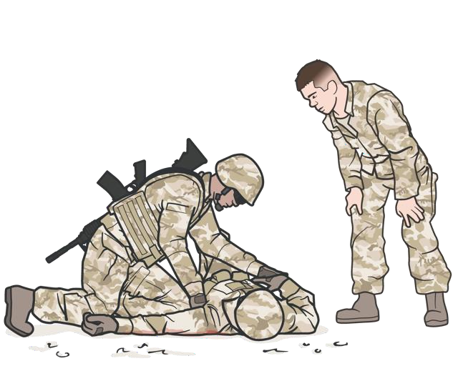
IMPORTANCE OF TCCC TRAINING
Module 1: Principles and Application of TCCC
Application of TCCC has resulted in the lowest preventable death rate ever
Individuals who are regularly trained in TCCC
are COMBAT-READY when they deploy
Units that train together perform more
efficiently in an operational setting
During training, CPPs can refine the Role 1 medical response, ensure unit CMC readiness, and identify outstanding performers to use as extenders and first responders who might benefit from additional mentorship
Notes:
It’s impossible to understate the value of training in TCCC. In addition to anecdotal stories about how TCCC has saved lives, irrefutable scientific evidence shows that TCCC principles will prevent deaths.¹² Units that have mandated initial and sustained training requirements have been shown to have better retention of knowledge and skills, which will translate into improved performance in an operational setting. Military units that have trained ALL of their members in TCCC have documented the lowest incidence of preventable deaths among their casualties in the history of modern warfare.¹³
In addition to the individual training on specific skills, unit-based training teaches the medical personnel and combat lifesavers/first responders how to work as a team, allowing them to be much more efficient when faced with a real-life situation.¹⁴

Slide 26

THE THREE OBJECTIVES OF TCCC
Module 1: Principles and Application of TCCC
Treat the casualty
Prevent additional casualties
Complete the mission
Notes:
Remember, the ongoing mission does not stop just because there is a casualty. The three objectives of TCCC are to:
Treat the Casualty – provide lifesaving care to the injured combatant.
Prevent Additional Casualties – limit the risk of taking further casualties.
Complete the Mission – enable the unit to achieve mission success.

Slide 27
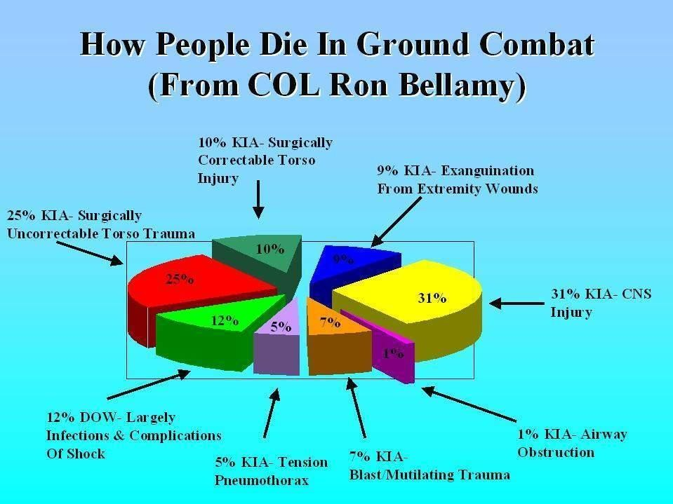
PREHOSPITAL TRAUMA CARE IN VIETNAM
Module 1: Principles and Application of TCCC
Over 2500 PREVENTABLE DEATHS from EXTREMITY
HEMORRHAGE occurred in Vietnam.
These casualties had no other injuries!
25 years later, we have still not learned the tourniquet lesson from Vietnam.
Notes:
This slide depicts a study that was done on soldiers who died in Vietnam. Two thousand and five hundred preventable deaths from extremity hemorrhage were the result.¹⁵ Tourniquets could have saved these lives.
Twenty-five years later, we had still not learned the tourniquet lesson from Vietnam. Instead, we can use this data to help us understand what types of injuries are seen in combat and which may or may not be survivable.

Slide 28
LIFESAVING IMPACTS OF IMPLEMENTING TCCC IN PREHOSPITAL TRAUMA CARE MID-1990s
Module 1: Principles and Application of TCCC
FATAL PENETRATING INJURIES MOGADISHU
Extremities
22% of these casualty’s died from
UNCONTROLLED HEMORRHAGE in
Mogadishu
HEMORRHAGE is the leading cause of combat death when evacuation is delayed for more than 6 hours
Though upgrades in body armor helped protect those that were injured, there is a need to improve the field management of hemorrhage
Thoracoabdominal
7%
7%
Head
Pelvis
36%
14%
14%
Abdomen
7%
Neck
14%
Chest
Thoracoabdominal
Head
Neck
Chest
Abdonmen
Pelvis
Extremities
#TCCC-CPP-PPT-01 08 AUG 23 28
Notes:
In this group of patients from Mogadishu Somalia in 1993, uncontrolled hemorrhage caused 22% of the fatalities.¹⁶ Hemorrhage continued to be a major cause of battlefield death and is the leading cause of combat death when evacuation is delayed for more than 6 hours.
The soldier who slowly exsanguinated from a proximal femoral artery and vein injury despite the efforts of a medic and others to stop the bleeding is a particularly poignant example. This again illustrates the point made by Bellamy in 1984,¹⁷ when in his discussion on improving the salvage of combat casualties, he stated, “First and foremost, there is a need to improve the field management of hemorrhage.”
Clearly, the management of choice for severe extremity hemorrhage is an effective tourniquet followed by surgical repair or ligation of the injured vessels. The incidence of fatal head wounds was similar to that in Vietnam in spite of modern Kevlar helmets. Body armor reduced the number of fatal penetrating chest injuries. Penetrating wounds to the unprotected face, groin, and pelvis caused significant mortality.
But what about injuries not amenable to a tourniquet, such as those to the lower abdomen, groin, axilla, and proximal extremities? What is the optimal management for these patients on the urban battlefield of the future, where evacuation may be significantly delayed?

Slide 29







LIFESAVING IMPACTS OF IMPLEMENTING TCCC IN PREHOSPITAL TRAUMA CARE CURRENTLY
Module 1: Principles and Application of TCCC
8 of 12
Deaths from potentially survivable injuries might have been prevented by the proper application of TCCC principles
Notes:
Tactical medical training historically was modeled on civilian courses like the Emergency Medical Technician (EMT) and Advanced Trauma Life Support (ATLS) courses and mirrored civilian trauma resuscitation guidelines, which provided excellent in-hospital care and results. But the principles they reflect often needed to be modified for the tactical setting, and that was not routinely done.¹⁸
In previous conflicts, the use of tourniquets was discouraged, crystalloid fluid resuscitation was used for shock, hemostatic agents were not available, and airways were established through endotracheal intubation. At the start of the war in Afghanistan, TCCC was used only by a few innovative units in the US military.¹⁹ The impact of this limited use of TCCC was not well-appreciated until the first preventable death analysis was conducted.²⁰ That study by Holcomb and others found that 8 of the 12 individuals who died from injuries that were potentially survivable might have been saved simply by the proper application of TCCC principles.

Slide 30

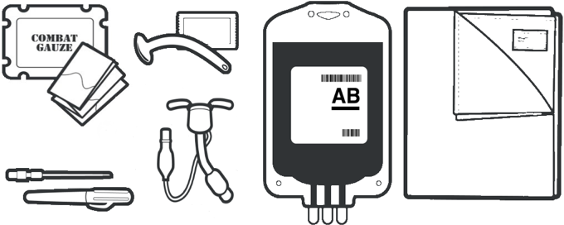
LIFESAVING IMPACTS OF IMPLEMENTING TCCC IN PREHOSPITAL TRAUMA CARE (cont.)
Module 1: Principles and Application of TCCC
In addition to tourniquet guidance, many other TCCC advances have now been widely adopted
Including: Hemostatic dressing and wound packing; junctional tourniquet, needle decompression of the chest, nasopharyngeal airway, cricothyroidotomy, extraglottic airway, resuscitation with blood products, and hypothermia prevention, to mention a few
Notes:
The experience with limb tourniquets was largely responsible for the adoption of TCCC throughout the US military.²¹ Tourniquets were a high-visibility issue for two reasons. First, tourniquet use was a radical departure from prehospital trauma care practice. Second, ubiquitous tourniquet use has clearly been the single most important lifesaving battlefield trauma care advance achieved during the wars in Iraq and Afghanistan.^{22,23}
The strategic messaging on tourniquets that drove the spread of TCCC from the Special Operations community to the conventional forces included reports of preventable death from extremity hemorrhage and documentation of improved survival as the use of extremity tourniquets became more prevalent. Now, in addition to evidence-based tourniquet guidance, many other TCCC advances have been adopted, such as hemostatic agents, needle decompression of the chest (NDC), advanced/surgical airways, resuscitation with blood products, and hypothermia prevention. These have not only had positive impacts on military prehospital trauma care but also have been widely adopted in the civilian community.²⁴

Slide 31
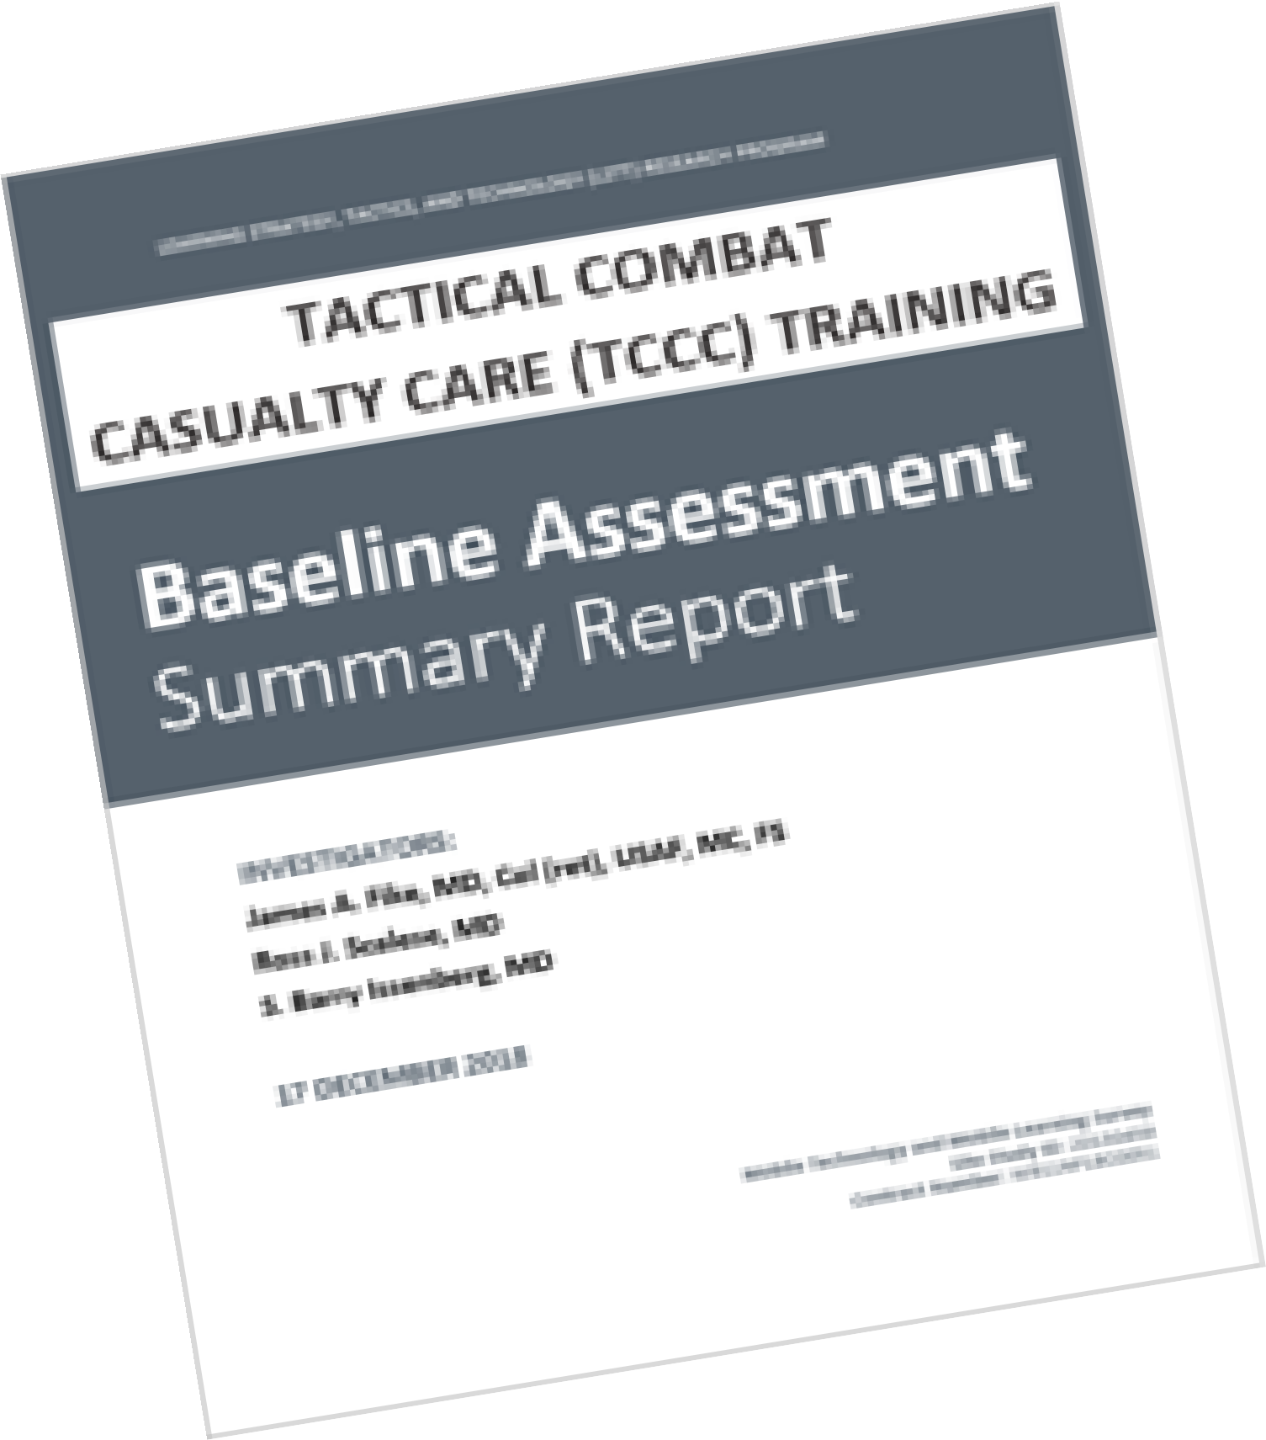

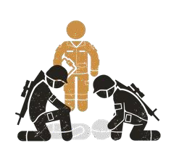
TCCC TRAINING METHODS TO ENSURE UNIT READINESS
Module 1: Principles and Application of TCCC
2018 TCCC Baseline Training Assessment
Main findings responsible for variations in training:
Inconsistent instructor
training and selection
Variable methods
of assessment
Lack of adequate physical space
Variations in simulation capabilities
Notes:
TCCC training methods that ensure unit readiness and support the achievement of no losses due to preventable combat deaths is a primary responsibility for the CPP, whether that be as the primary medic for a unit or as medical director overseeing the Role 1 medical system involving additional medical resources.
The establishment of standardized training programs and resources will help to correct some of the disparities that have been seen between units and Services, but is not, in and of itself, the complete solution to a robust training platform that ensures maximum readiness. Even with the prior standardized TCCC-All Combatant and TCCC-Medical Provider materials and National Association of Emergency Medical Technician-certified instructors, there was significant variation within training programs in a 2018 TCCC baseline training assessment for the Defense Health Agency.²⁵
The main findings responsible for the variations were inconsistent or inadequate instructor training and selection, variable methods of assessment, lack of adequate physical space for both classroom and practical training, and variations in simulation capabilities. A common finding during the assessment was that units did not prioritize TCCC training for either their medics or their other personnel.

Slide 32

Module 1: Principles and Application of TCCC
TCCC TRAINING METHODS TO ENSURE UNIT READINESS
Recommendations to optimize training outcomes
Ensure line leadership prioritizes TCCC training Use the approved Joint Trauma System resources Properly-trained and up-to-date instructors
Incorporate real-world experiences and case scenario-based examples
Provide the most realistic training environment you can Use standardized assessments, constructive feedback and
remediation
Incentivize training outside of formal classes (e.g., Deployed
Medicine)
Notes:
To ensure your TCCC training programs are optimized, several issues should be highlighted:
Ensure that your line leadership understands the need for prioritizing TCCC training
As core training plan and materials, use the approved Joint Trauma System resources
Make sure all instructors are properly trained & stay up-to-date with curriculum changes
Incorporate real-world experiences and case scenario-based examples in the training
Provide the most realistic training environment you can
Use standardized assessments with constructive feedback and remediation, as needed
Incentivize ongoing training outside of formal classes (e.g., Deployed Medicine)

Slide 33
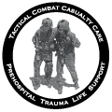
Module 1: Principles and Application of TCCC
THE ORIGINS OF TCCC AND THE COMMITTEE ON TCCC (CoTCCC)
WWII, Korea, Vietnam conflict experiences Somalia
Initial TCCC Guidelines
NAVSPECWARCOM, 75th Rangers, USAF PJs adopt TCCC
CoTCCC chartered by USSOCOM
1940-1975
1992
1996
Late 1990s
2001
2002
2003
2004
2006
2007
2013
2021
CENTCOM Joint Theater Trauma System established
1st TCCC Guideline update DOD Trauma Registry chartered
Joint Trauma System (JTS) established
CoTCCC moves to Defense Health Board CoTCCC moved under JTS
Most recent TCCC Guideline update
The CoTCCC mission is
“To develop on an ongoing basis the best possible set of trauma care guidelines customized for the tactical environment and to facilitate the transition of these recommendations into battlefield trauma care practice.”
Notes:
TCCC, as a formalized set of guidelines and subsequent evolvement into a curriculum began with the 1996 publication of the first set of TCCC Guidelines in an article by CAPT Frank Butler.²⁶ But many of the concepts and experiences that led to that publication occurred in the years prior and drew from articles and research that dated back as far as our previous conflicts but was never institutionalized.^{27,28}
In the late 1990s, these concepts of TCCC were presented to the Joint Staff Surgeon and subsequently to senior leaders of the Military Health System, but no specific plan of action emerged from the briefings. They were also presented at a series of both military and civilian medical conferences, but there was no DoD-level effort to revamp prehospital combat casualty care practice.²⁹
However, the Naval Special Warfare Command, the 75th Ranger Regiment, the Army Special Missions Unit, and the Air Force pararescue community all individually adopted the guidance and were the only units implementing the Guidelines at the start of the war in Afghanistan.³⁰ Afterwards, as we just mentioned, the concepts and guidance spread from these innovative units to the general purpose forces, and most recently has been adopted as the standard of care for medical training for all Service members, Combat Lifesavers, and medical personnel.
In 2001, a medical research effort by the U.S. Special Operations Command (USSOCOM) led to the development of a Committee on TCCC (CoTCCC), which was first established at the Naval Operational Medicine Institute. A significant aspect of the committee composition is that 30% of the voting members should be comprised of active or former combat medics and paramedics, corpsmen, and pararescuemen (PJs). The remainder of the 42-person voting membership includes all Services, various surgical specialties, emergency medicine and combat medical educators, including physicians, physician assistants, nurses and medical planners.
After several years as a research-funded activity, the CoTCCC was moved to the Defense Health Board in 2007 and subsequently to the Joint Trauma System (JTS) in 2013 after it was formally established.³¹ Although the JTS has been realigned a few times since 2013, CoTCCC has remained a primary JTS committee and priority throughout its evolution.
The CoTCCC mission is “To develop on an ongoing basis the best possible set of trauma care guidelines customized for the tactical environment and to facilitate the transition of these recommendations into battlefield trauma care practice.”³² Guideline updates have occurred periodically since 1996, the first time in 2003³³ up through the most recent version released in November of 2020. In addition to routine meetings involving the entire COTCCC membership, subcommittees and specialized ad hoc groups are formed, as needed, to address specific issues that may ultimately be presented to the larger group for consideration.

Slide 34

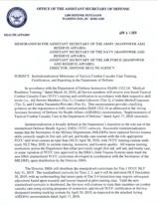


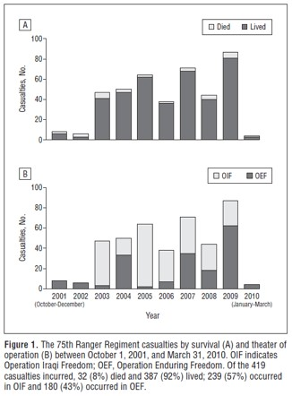
THE IMPORTANCE OF CoTCCC GUIDELINES & RECOMMENDATIONS
Module 1: Principles and Application of TCCC
Prehospital advances implemented by TCCC have improved the probability that casualties will arrive at the hospital alive so they can benefit from the trauma care system now in place.
Highlighted in Key DOD Policies
ASD-HA Policy: Institutionalization
Milestones of TCCC Training
ASD-HA Policy: DOD Lifesaving
Materiel
DODI 1322.24:
Medical Readiness Training
Notes:
The recommendations of CoTCCC and the TCCC Guidelines they produce form the backbone of TCCC training and prehospital care for the DOD. Recent policy statements from the Assistant Secretary of Defense for Health Affairs highlight the importance of these guidelines and recommendations in training³⁴ and choosing lifesaving material (equipment for use in TCCC),³⁵ in addition to the DOD instruction on TCCC training for All Service Members.³⁶
Although the importance of the CoTCCC Guidelines and recommendations is highlighted by the emphasis placed on it through policy statements, the impact that the guidance has had on casualty outcomes really validates their importance. Beginning with initial studies that demonstrated improved survival when responders followed TCCC guidance,^{37,38} research has shown that adhering to the recommendations of CoTCCC and using the TCCC Guidelines positively affects casualty outcomes.^{39,40,41}
A primary reason that the recommendations and guidance remain important tools for prehospital medical personnel is that they are not based on anecdotal experiences or outcomes from individual scenarios but use an evidence-based approach that is augmented by the subject matter expertise of very combat-experienced professionals. This applies not only to the treatment guidelines and clinical practice guidelines but to recommendations for equipment and TCCC training.

Slide 35




Module 1: Principles and Application of TCCC
TCCC GUIDELINE CHANGE METHODOLOGY
Identify issues for consideration
Initial review by CoTCCC
Subject Matter Expert(s)
CoTCCC-appointed panel research and review
Findings presented to
CoTCCC membership
New technologies Lessons identified Research findings Routine guideline
reviews
Consider further
Collect more information
Hold off on moving
forward for the time
Literature reviews
Focused additional research
Coordination with other
subject matter experts
Materials studied in advance
Deliberations/ discussions
Vote on need to change and final recommendations
Notes:
Another important point to highlight is that the landscape of prehospital medical care is constantly changing and evolving. As we enter an era where we may be involved in more anti-access and area denial missions that use units with smaller footprints in environments that are less permissive, the need for prolonged field care will likely become more important with longer evacuation times. New technologies will continue to be developed that enhance forward delivery of medical care. In this ever-changing environment, guidelines and recommendations will need to adapt and change.
CoTCCC and the JTS have a process to ensure the TCCC Guidelines remain relevant and stay updated. The first step is the identification of issues that could be considered for a formal review. These range from the advent of new technologies and equipment, to the findings of combat casualty care reviews through the DOD Trauma Registry or other research efforts, to lessons identified in current operations, to routine reviews of existing recommendations to ensure they are founded on sound evidence-based guidance. Often this comes through CoTCCC members at routine meetings, but it can certainly be identified by other medics based on their knowledge, experiences or research.
Potential issues are then identified to select CoTCCC members for consideration. Sometimes, the need to pursue the issue further is very obvious, and it will move to the next stage without being introduced to the entire CoTCCC membership. Other times, the issue will be forwarded to the larger membership body for consideration as a new project (either at an in-person meeting or through a less formal process of reaching out to the members individually). Based on the collective response, the issue may move to the next stage, but sometimes the choice is to not pursue the issue further at that time, leaving room open to readdress the issue at a later date.
The next stage involves the selection of a small group of people, led by a champion, to address the issue and prepare a course of action and recommendations for the CoTCCC membership. This stage could involve doing a retrospective review of literature, it might require some deliberate research (particularly in the cases of new technology recommendations), and it almost always involves coordination with subject matter experts inside and from outside of CoTCCC membership. The end result of this most complicated phase is a set of recommendations for the CoTCCC membership to consider.
Once that information has all been gathered and put together, the issue is brought before the CoTCCC members for deliberation. This can be done at the routinely scheduled CoTCCC meetings (often held twice a year), but an ad hoc meeting can also be convened. A routine meeting either is limited in time or will not occur in time to address a time-sensitive issue. Read-aheads are provided, but there is an open discussion, and debate is encouraged prior to voting. The membership ultimately votes on anything that might result in a Guideline change or formal CoTCCC recommendation. The minutes from those meetings are openly available on the JTS website.
Changes to the Guidelines may be validated, but a completely new version might not be issued pending other outstanding issues, to prevent version changes from occurring too frequently (CoTCCC may choose to reissue the Guidelines once several changes are approved). In the interim, each pending change will be highlighted so anyone who might be affected can prepare for the upcoming modifications. Also, in the case of most changes, a formal change paper is written, providing a summary of the information that formed the basis for the CoTCCC discussions. These are often published in the Journal of Special Operations or in Military Medicine.

Slide 36
Module 1: Principles and Application of TCCC
ASSESSING THE EVIDENCE FOR GUIDELINES
Level of Evidence | AHA Recommendation System Terminology Explanation | Why the AHA Classification System?
A | Evidence from multiple randomized clinical trials (RCT) with concordant results or from HIGH-QUALITY meta-analyses. | The level of evidence recommendations allow readers to quickly glean information on the strength, certainty, and quality of evidence supporting each recommendation. A recommendation with Level of Evidence (LOE) C does not imply that the recommendation is weak. Although, RCTs are unavailable, there may be a very clear clinical consensus that a particular test or therapy is useful or effective.
B-R | Evidence from moderate-quality trials, or a meta-analysis of moderate quality (RCT) followed by an R to denote RANDOMIZED studies
B-NR | Evidence from moderate-quality trials, or a meta-analysis of moderate quality followed by NR to denote NON-RANDOMIZED studies
C-LD | There is no convincing evidence and is followed by LD to indicate LIMITED DATA
C-EO | There is no convincing evidence and is followed by EO if the consensus is based on EXPERT OPINION, case studies or standards of care.
Notes:
Throughout the course, you will see comments referring to the evidence behind guidelines and recommendations. Evidence-based recommendations and guidance are the result of a careful review of studies and discussion by a panel of subject matter experts. For TCCC, the subject matter expert panels include both Committee on TCCC members, and select invited subject matter experts from within both the military and civilian community, based on the specific interest area.
A common approach is the Grading of Recommendations Assessment, Development, and Evaluation (GRADE) system, which rates the quality of evidence, then balances that with the outcomes (desirable and undesirable) to provide a recommendation with a comment about the certainty of the evidence. But there are other similar methodologies used by professional organizations, as well.
The quality of the evidence looks at variables like the number of studies on the area of interest, any limitations of the study, biases, consistencies, sample sizes, and statistical strengths of the results, among other things. In general, randomized, controlled studies with statistically significant findings are graded higher and observational studies with equivocal to mildly significant findings are graded lower. And consensus subject matter expert opinions without observational (or randomized) studies are also graded lower.
But keep in mind, that in the absence of clear evidence from formal studies, the use of consensus opinions is considered a best practice, which should be accompanied by simultaneous research to study that area of interest and ultimately provide evidence to support that opinion or alter the recommendation.
Guyatt G, et al. GRADE guidelines: 1. Introduction – GRADE evidence profiles and summary of findings tables. J Clinical Epidemiology. 64(2011):383-394.
Guyatt G, et al. GRADE guidelines: 1. Introduction – GRADE evidence profiles and summary of findings tables. J Clinical Epidemiology. 64(2011):383-394.

Slide 37
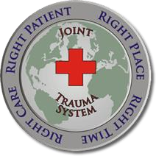

JOINT TRAUMA SYSTEM MISSION AND ROLE AT THE UNIT LEVEL
Module 1: Principles and Application of TCCC
JTS SUPPORT TO UNITS
Developing and maintaining clinical practice guidelines (CPGs) and TCCC Guidelines
Recommending combat casualty care training
requirements
Evaluating and recommending new equipment or
medical supplies
Providing units with up-to-date information to help tailor
unit training and procedures
Improving communication and facilitating movement,
collection, and sharing of theater combat casualty data
Maintaining the Department of Defense Trauma Registry
Improving the organization and delivery of trauma care
The mission of the Joint Trauma System (JTS) is to improve trauma readiness and outcomes through evidence-driven performance improvement.
Notes:
The mission of the Joint Trauma System (JTS) is to improve trauma readiness and outcomes through evidence-driven performance improvement. And the vision of the Joint Trauma System is that every Soldier, Sailor, Airman, and Marine injured on the battlefield or in any theater of operations will be provided with the optimum chance for survival and maximum potential for functional recovery.⁴²
Military trauma system deficiencies were noted in reports from Operation Desert Shield and Desert Storm in 1992.⁴³ Then, after the terrorist attacks of September 11, 2001, the increase in armed conflict and subsequent battlefield injuries again raised questions about how to improve the military trauma response, as the absence of trauma experts and a trauma system was glaring.⁴⁴
COL John Holcomb, MD, was deployed to examine the trauma system and make recommendations for improvement. The result was a Central Command Joint Theater Trauma System (JTTS), which later became the Joint Trauma System in 2006.^{45,46} After several organizational changes, it has been designated as the lead agency for trauma in DoD with authority to establish and assure best-practice trauma care guidelines.⁴⁷
The JTS consists of six principal entities:⁴⁸
DOD Trauma Registry Management
Defense Committee on Trauma
Performance Improvement
Combatant Command Trauma System Management
Joint Trauma Education and Training
Defense Medical Readiness Institute
The Committee on Tactical Combat Casualty Care is a committee under the Defense Committee on Trauma, along with the Committee on En Route Combat Casualty Care and the Committee on Surgical Combat Casualty Care.
Several key JTS functions play roles in combat casualty care at the unit level:
Developing and maintaining evidence-supported clinical practice guidelines (CPGs) – supporting the unit medics with concise and subject matter expert-vetted TCCC Guidelines and other CPGs.
Recommending combat casualty care training requirements – providing resources and training recommendations for unit personnel, both medical and nonmedical.
Evaluating and recommending new equipment or medical supplies – providing units with well-researched objective advice on equipment and supplies so that they do not need to do independent research.
Facilitating medical performance improvement by promoting real-time, data-driven clinical process improvements and improved outcomes – providing units with up-to-date information to help tailor unit training and procedures more rapidly than in prior years.
Improving communication and facilitating movement, collection, and sharing of theater combat casualty data across all roles of care and all the Military Services – supporting the key roles of communication and documentation at a unit level, in addition to higher levels.
Maintaining the Department of Defense Trauma Registry (DoDTR) on DoD injury demographics, care provided, and outcomes – supporting communication with unit leadership and identifying any unit-specific trends.
Improving the organization and delivery of trauma care – helping unit medics to organize, train and equip in support of their leadership and unit personnel. The JTS website has many documents and other information that can answer trauma-related questions and help you manage unit TCCC training. Additionally, their contact information has different links for the various JTS functions that you might need to access at a unit level.

Slide 38
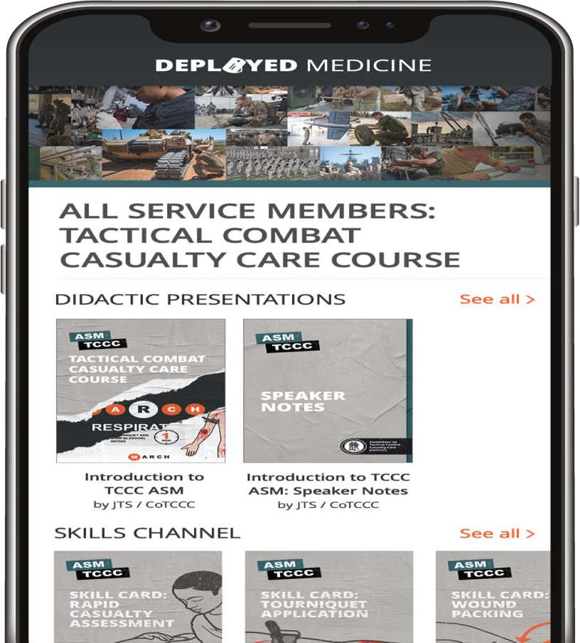



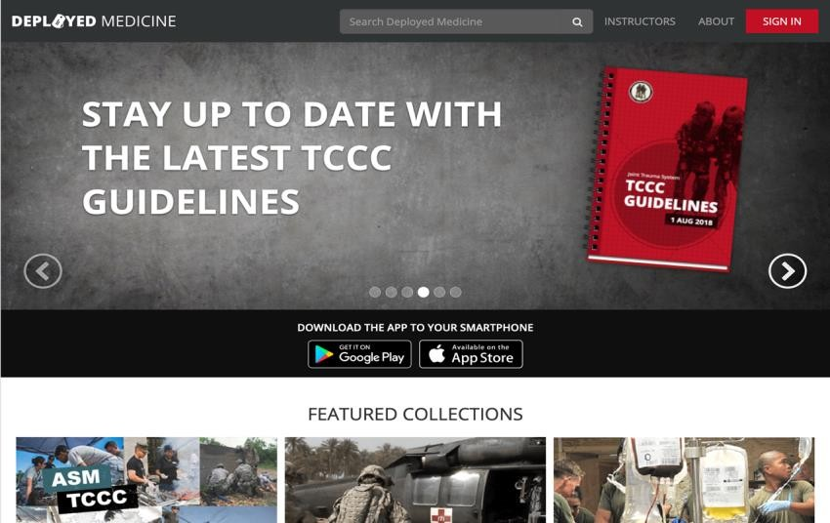


STAYING UP-TO-DATE WITH TCCC GUIDELINES AND PROTOCOLS
Module 1: Principles and Application of TCCC
The TCCC Guidelines are reviewed quarterly and updated as needed by CoTCCC
Once approved by the Director of the Joint Trauma System (JTS), the updated version of the TCCC Guidelines is published through:
www.deployedmedicine.com
Defense Health Agency
deployedmedicine.com
#TCCC-CPP-PPT-01 08 AUG 23
38
Notes:
The need for periodic updates to the TCCC Guidelines was recognized early in the development of TCCC. The original TCCC paper recommended that the TCCC Guidelines be updated as needed by a Department of Defense-sponsored committee established for this purpose – the Committee on Tactical Combat Casualty Care, or CoTCCC. The TCCC Guidelines are reviewed quarterly and updated as needed by CoTCCC.
The guidelines are published in a few places; however, Deployed Medicine is the official website to get the most up-to-date TCCC materials. Even though it is a .com website, it is an official site owned and managed by the Department of Defense. As soon as TCCC Guideline updates are approved for distribution by the Director of the Joint Trauma System (JTS), they will be updated directly onto Deployed Medicine.

Slide 39
SUMMARY
Module 1: Principles and Application of TCCC
Knowledge Topics
Knowledge Topics
Leading causes of preventable death due to traumatic injuries and the corresponding interventions
TCCC Phases of Care and how intervention priorities
differ in each phase
Application of TCCC in combat and noncombat settings
across different environments
Role and responsibilities of all non-medical and
medical personnel in rendering TCCC care
Key Factors influencing and the importance of TCCC
training
The three objectives or goals of TCCC
Lifesaving impacts of TCCC implementation in prehospital trauma care
Methods used to stay current and up to date
with TCCC Guidelines and protocols
Origins of TCCC, including the Committee on
Tactical Combat Casualty Care (CoTCCC)
Methodology for TCCC Guideline changes and
revisions
TCCC training methods ensuring unit readiness in achieving no losses due to preventable combat deaths
The mission and purpose of the Joint Trauma System and its role in combat casualty care at the unit level
#TCCC-CPP-PPT-01 08 AUG 23 39
Notes:
Respiration assessment and management is a vital Tactical Field Care skill that includes recognition and treatment of tension pneumothorax, one of the most common causes of preventable death on the battlefield.
We began by reviewing the basic concepts and signs and symptoms of respiratory distress and life-threatening chest injuries. Then we discussed open pneumothorax, focusing on the pathophysiology to understand why chest seals are recommended and how they work. We also talked about the evidence supporting the recommendation to use vented chest seals when they are available.
Afterward, we reviewed tension pneumothorax and how to recognize it, as well as the effects it has on an injured casualty. We talked about treatment with chest seals when present, but also about the importance of needle decompression of the chest and the sites available to us when performing an NDC.
We also discussed what to do for unsuccessful NDC attempts and recurrent tension pneumothorax symptoms, including the use of finger and/or tube thoracostomies by providers trained and authorized to perform those procedures.

Slide 40

CHECK ON LEARNING
Module 1: Principles and Application of TCCC
Which factors influence TCCC?
What are the phases of care in TCCC?
What is the most essential treatment task in CUF / Threat? What is every first responder’s role in CUF / Threat?
What does MARCH PAWS stand for?
40
Notes:
Answers
Which factors influence TCCC?
Hostile fire, tactical considerations, wounding patterns, environmental considerations, level of first-responder training and experience, equipment constraints, and the potential for significant delays in evacuation.
What are the phases of care in TCCC?
Care Under Fire, Tactical Field Care, and Tactical Evacuation Care.
What is the most essential treatment task in CUF/Threat?
Application of a limb tourniquet to control massive bleeding.
What is every first responder’s role in CUF/Threat?
Suppress hostile fire and/or establish scene safety, assist in self-aid, and assist in moving casualties, if feasible.
What does MARCH PAWS stand for?
Massive bleeding
Airway
Respirations (breathing)
Circulation
Hypothermia AND head injury
Pain
Antibiotics
Wounds
Splints

Slide 41




Module 1: Principles and Application of TCCC
ANY QUESTIONS?
#TCCC-CPP-PPT-01 08 AUG 23
41

Slide 42

REFERENCES
Module 1: Principles and Application of TCCC
TCCC: Guidelines
by JTS/CoTCCC
These guidelines, updated regularly, are the result of decisions made by CoTCCC in exploring evidence-based research on best practices.
PHTLS: Military Edition, Chapter 25
by NAEMT
Prehospital Trauma Life Support (PHTLS), Military Edition, teaches and reinforces the principles of rapidly assessing a trauma patient using an orderly approach.
#TCCC-CPP-PPT-01 08 AUG 23
42
Notes:
¹ DOD Instruction 1322.24. Medical Readiness Training. 16 March 2018. Accessed at https://www.esd.whs.mil/Portals/54/Documents/DD/issuances/dodi/132224p.pdf?ver=2018-03-16-140510-410, Change 1 Effective 15 February 2022.
² www.deployedmedicine.com
³ Eastridge BJ, Mabry RL, et al. Death on the battlefield (2001-2011): implications for the future of combat casualty care. J Trauma Acute Care Surg. 2012 Dec;73(6 Suppl 5): S431-7.
⁴ Butler FK Jr, Hagmann J, Butler EG. Tactical combat casualty care in special operations. Mil Med. 1996 Aug;161 Suppl: 3-16.
⁵ Tactical Combat Casualty Care Guidelines, 15 December 2021, https://deployedmedicine.com/market/31/content/40
⁶ Tactical Combat Casualty Care Guidelines, 15 December 2021, https://deployedmedicine.com/market/31/content/40, accessed 14 Nov 21.
⁷ Tactical Combat Casualty Care Guidelines, 15 December 2021, https://deployedmedicine.com/market/31/content/40,
⁸ Jacobs LM, McSwain NE Jr, Rotondo MF, Wade D, Fabbri W, Eastman AL, Butler FK Jr, Sinclair J; Joint Committee to Create a National Policy to Enhance Survivability from Mass Casualty Shooting Events. Improving survival from active shooter events: the Hartford Consensus. J Trauma Acute Care Surg. 2013 Jun;74(6): 1399-400.
⁹ Ritenour AE, Baskin TW. Primary blast injury: update on diagnosis and treatment. Crit Care Med. 2008 Jul;36(7 Suppl): S311-7.
¹⁰ Tactical Combat Casualty Care Skill Sets by Responder Level, Deployed Medicine website: https://learning-media.allogy.com/api/v1/pdf/63ad6e0e-aff7-497c-a7db-394570021997/contents, accessed 19 Nov 21.
¹¹ Butler FK Jr, Hagmann J, Butler EG. Tactical combat casualty care in special operations. Mil Med. 1996 Aug;161 Suppl: 3-16.
¹² Butler FK. Two Decades of Saving Lives on the Battlefield: Tactical Combat Casualty Care Turns 20. Mil Med. 2017 Mar;182(3): e1563-e1568.

